Slide 1
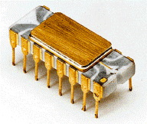
Microprocessor
DIVYA Singh
Assistant professor

Slide 2
What is a Microprocessor?
The word comes from the combination micro and processor.
- Processor means a device that processes whatever. In this context processor means a device that processes numbers, specifically binary numbers, 0’s and 1’s.

Slide 3
What about micro?
In the late 1960’s, processors were built using discrete elements. • These devices performed the required operation, but were too large and too slow.
– In the early 1970’s the microchip was invented. All of the components that made up the processor were now placed on a single piece of silicon. The size became several thousand times smaller and the speed became several hundred times faster. The “Micro”Processor was born.

Slide 4
Definition of Microprocessor
The microprocessor is a multipurpose, clock driven, register based, digital integrated circuit that accepts binary data as input, processes it according to instructions stored in its memory, and provides results as output.

Slide 5
Definition (contd.)
The microprocessor is a programmable device that takes in numbers, performs on them arithmetic or logical operations according to the program stored in memory and then produces other numbers as a result.

Slide 6
Programmable device: The microprocessor can perform different sets of operations on the data it receives depending on the sequence of instructions supplied in the given program. By changing the program, the microprocessor manipulates the data in different ways.
Instructions: Each microprocessor is designed to execute a specific group of operations. This group of operations is called an instruction set. This instruction set defines what the microprocessor can and cannot do.

Slide 7
Takes in: The data that the microprocessor manipulates must come from somewhere.
It comes from what is called “input devices”.
These are devices that bring data into the system from the outside world.
These represent devices such as a keyboard, a mouse, switches, and the like.

Slide 8
Numbers:
The microprocessor has a very narrow view on life. It only understands binary numbers.
A binary digit is called a bit (which comes from binary digit).
The microprocessor recognizes and processes a group of bits together. This group of bits is called a “word”.
The number of bits in a Microprocessor’s word, is a measure of its “abilities”.

Slide 9
Words, Bytes
The earliest microprocessor (the Intel 8088 and Motorola’s 6800) recognized 8-bit words.
– They processed information 8-bits at a time. That’s why they are called “8- bits processors”.
- They can handle large numbers, but in order to process these numbers, they broke them into 8-bit pieces and processed each group of 8-bits separately.
Later microprocessors (8086 and 68000) were designed with 16-bit words.
– A group of 8-bits were referred to as a “half-word” or “byte”.
– A group of 4 bits is called a “nibble”.
– Also, 32 bit groups were given the name “long word”.

Slide 10
Stored in memory :
What is memory?
– Memory is the location where information and data is kept.
Memory is usually measured by the number of bytes it can hold. It is measured in Kilos, Megas and lately Gigas. A Kilo in computer language is 1K =1024. So, a 1KB (KiloByte) is 1024 bytes. Mega(1M) is 1024 Kilos and Giga(1G) is 1024 Mega.

Slide 11
Stored in memory :
When a program is entered into a computer, it is stored in memory. Then as the microprocessor starts to execute the instructions, it brings the instructions from memory one at a time.
Memory is also used to hold the data. – The microprocessor reads (brings in) the data from memory when it needs it and write.

Slide 12
Produces:
For the user to see the result of the execution of the program, the results must be presented in a human readable form.
The results must be presented on an output device.
This can be the monitor, a paper from the printer, a simple LED or many other forms.

Slide 13
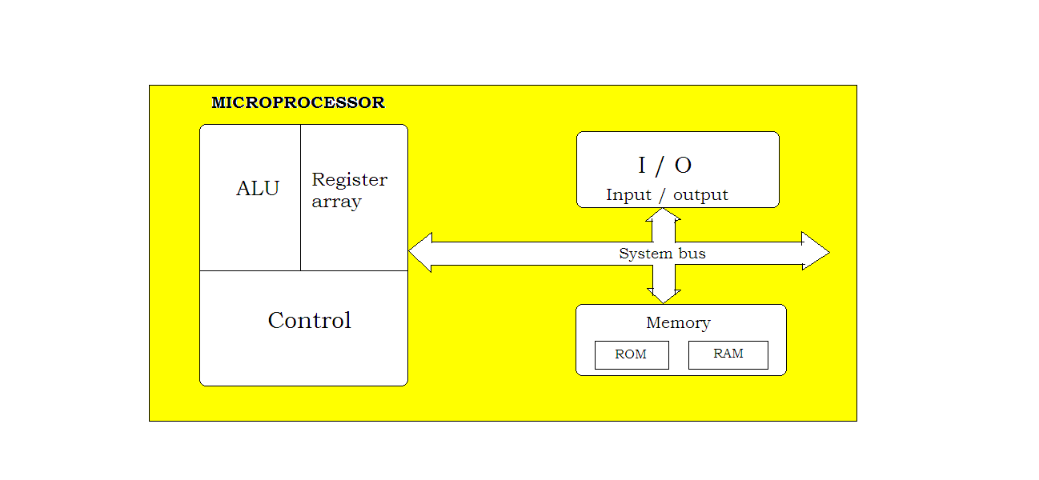
MICROPROCESSOR
Based System with Bus Architecture

Slide 14
Difference between Microprocessor and Microcontroller
Microprocessor is a programmable multi-purpose silicon chip. It’s like a heart of the computer system which consists of ALU (Arithmetic Logic Unit), Control Unit, instruction decoders, and Register Array.
Microprocessor is just an integrated circuit with no RAM, ROM, or input/output pins. It incorporates the functions of a CPU into a single integrated circuit.
Microprocessors are based on von Neumann architecture.
Not designed for specific task.
Microcontroller is the heart of the embedded system which is a byproduct of the microprocessor technology.
Microcontrollers, on the other hand, are more powerful devices which contain the circuitry of microprocessor and have RAM, IO, and processor all in a single chip.
Microcontrollers, on the other hand, are based on the Harvard architecture where instructions and program data are stored separately.
it’s designed to perform specific tasks.

